Slide 1



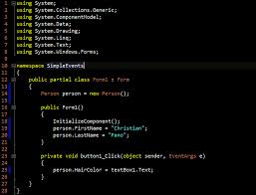
Survey of
Scientific Computing
(SciComp)
Unit 1
Compilers

Slide 2
Goals
Understand the Purpose of a Compiler and IDE
Learning by use of Console Programs
Get familiar the our IDE: Codeblocks
Lab 1: Hello World!

Slide 3
What is a compiler?
Computers understand only one language and that language consists of sets of instructions made of ones and zeros. This computer language is appropriately called machine language. A single instruction to a computer could look like this:
A particular computer's machine language program that allows a user to input two numbers, adds the two numbers together, and displays the total could include these machine code instructions:
00000 | 10011110
00000 | 10011110
00001 | 11110100
00010 | 10011110
00011 | 11010100
00100 | 10111111
00101 | 00000000

Slide 4
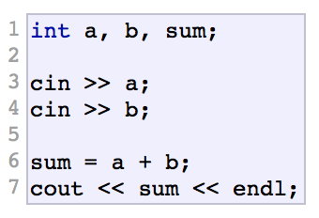
What is a compiler? Cont.
As you can imagine, programming a computer directly in machine language using only ones and zeros is very tedious and error prone. To make programming easier, high level languages have been developed. High level programs also make it easier for programmers to inspect and understand each other's programs easier. This is a portion of code written in C++ that accomplishes the exact same purpose:
Even if you cannot really understand the code above, you should be able to appreciate how much easier it will be to program in the C++ language as opposed to machine language. Because a computer can only understand machine language and humans wish to write in high level languages high level languages have to be re-written (translated) into machine language at some point. This is done by special programs called compilers, interpreters, or assemblers that are built into the various programming applications. C++ is designed to be a compiled language, meaning that it is generally translated into machine language that can be understood directly by the system, making the generated program highly efficient. For that, a set of tools are needed, known as the development toolchain, whose core are a compiler and its linker.

Slide 5
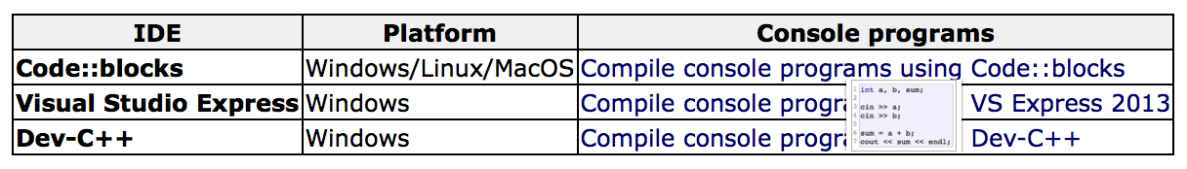
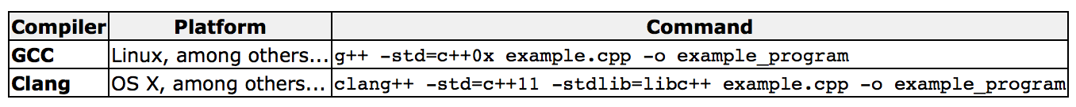
Console Programs
Console programs are programs that use text to communicate with the user and the environment, such as printing text to the screen or reading input from a keyboard.
Console programs are easy to interact with, and generally have a predictable behavior that is identical across all platforms. They are also simple to implement and thus are very useful to learn the basics of a programming language: The examples in these tutorials are all console programs. The way to compile console programs depends on the particular tool you are using. The easiest way for beginners to compile C++ programs is by using an Integrated Development Environment (IDE). An IDE generally integrates several development tools, including a text editor and tools to compile programs directly from it. Here you have instructions on how to compile and run console programs using different free Integrated Development Interfaces (IDEs):
If you happen to have a Linux or Mac environment with development features, you should be able to compile any of the examples directly from a terminal just by including C++11 flags in the command for the compiler:

Slide 6
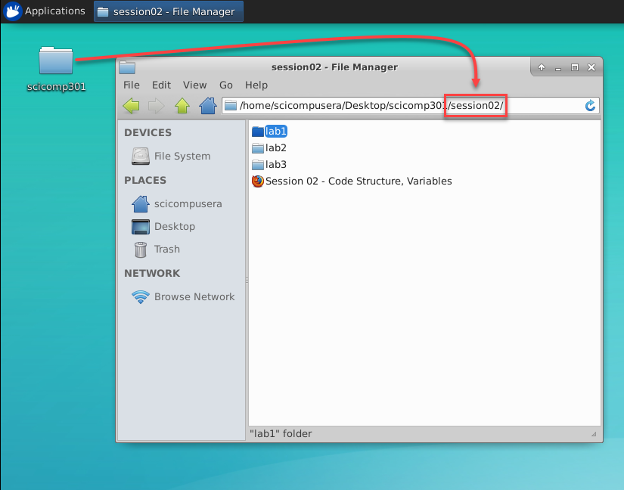
Lab 1 – Hello World!
Open the “lab1” folder

Slide 7
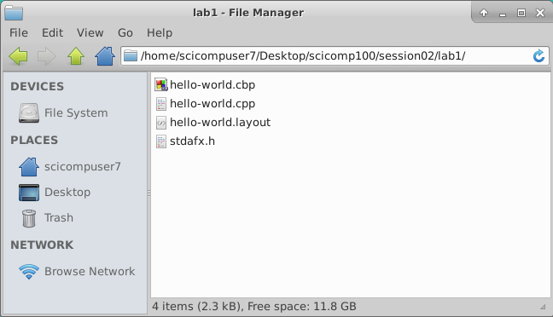
Lab 1 – Hello World!
Double click on the “.cbp” file to open the Code::Blocks Project

Slide 8
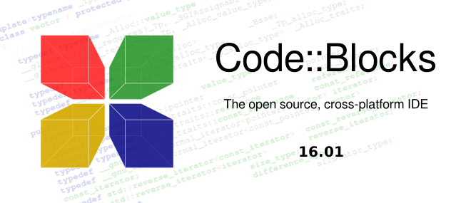
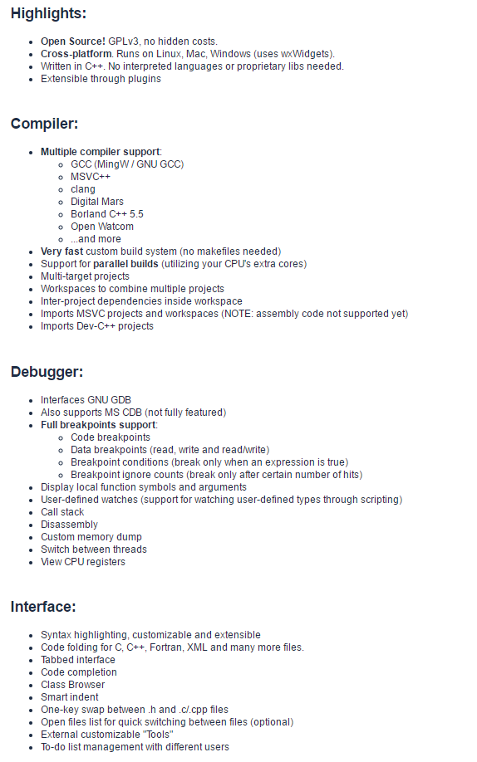
http://www.codeblocks.org

Slide 9
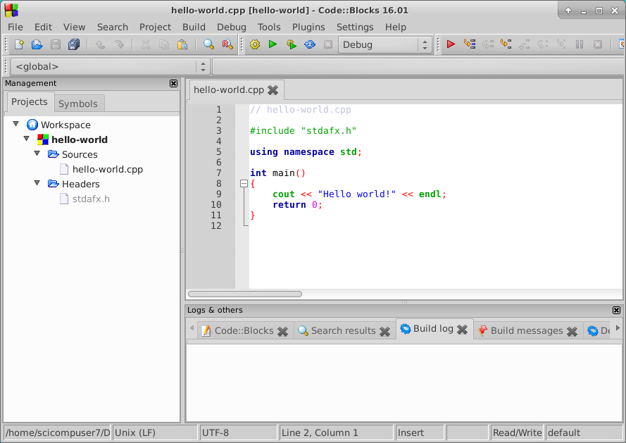
Lab 1 – Hello World!
Double click on the “.cpp” (C++) file that matches the lab topic

Slide 10

Lab 1 – Hello World!
To run the application, click on the green triangle with the gear symbol

Slide 11
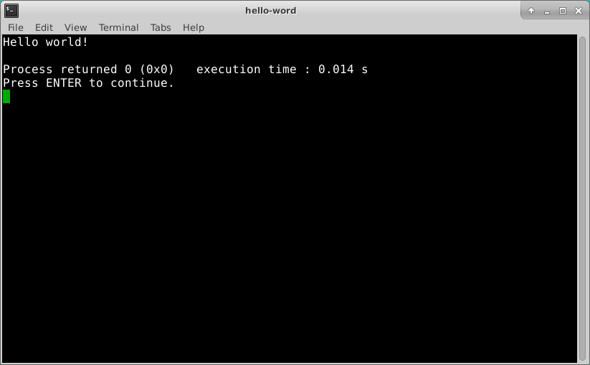
Lab 1 – Hello World!
Close the Terminal window and return to Code::Blocks

Slide 12
Hints on Using Xfce & Code::Blocks
Terminal = Shell = Console = Command Line
The shell is used to interact with character mode applications
Linux programmers mostly use the command line
Shell commands and file names are case-sensitive
Don’t accumulate open terminal windows – close them!
Only keep one (1) instance of Code::Blocks open
After each lab, close all open instances of Code::Blocks
To open a lab, be sure to double-click on the .cbp file (.cpp!)
Your session will auto-logout after an hour of of inactivity

Slide 13
Now you know…
Understand the Purpose of a Compiler and IDE
Learning by use of Console Programs
Get familiar the our IDE: Codeblocks
Basic understanding of the program layout- Lab 1: Hello World!

